Slide 1

Practice Your Programming with Katas
Session 4: Able was I, ere I saw Elba!

Slide 2

Week 4: Palindromes
A palindrome is a word, sentence or number (or some combination of those) that has the same letter and number order forwards and backwards.
An example would be “A Man, A Plan, a Canal: Panama!”
Write a function to determine if a given string is a palindrome:
It will accept a string
It should return True or False
Test cases: http://eca-python/katas4

Slide 3
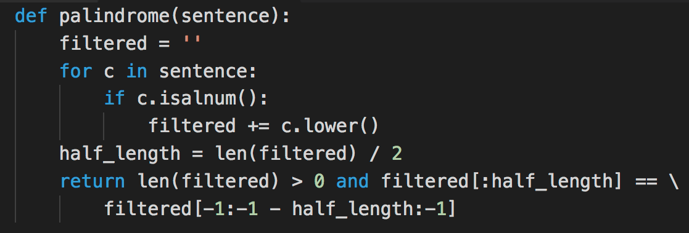
isalnum() tells us what to care about

Slide 4
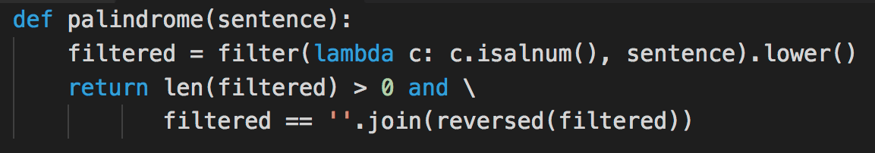
Filtering the sentence

Slide 5
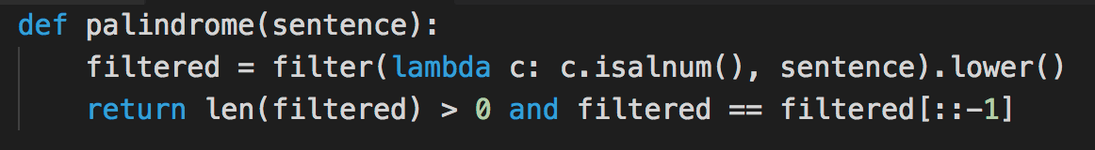
Slicing up the lists

Slide 6
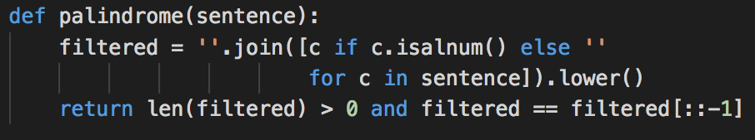
List comprehension instead of filter()?

Slide 7
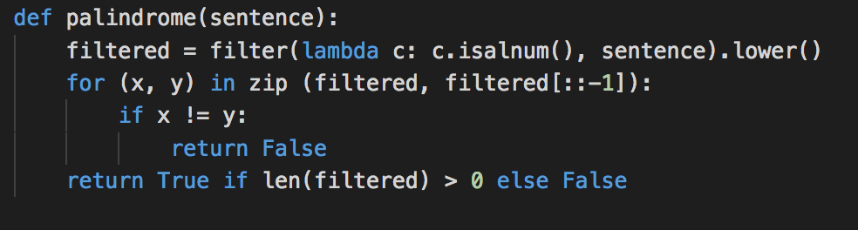
Zipping about

Slide 8
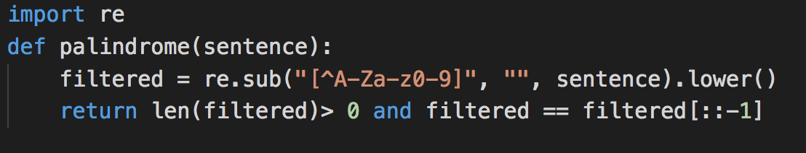
Two Problems

Slide 9
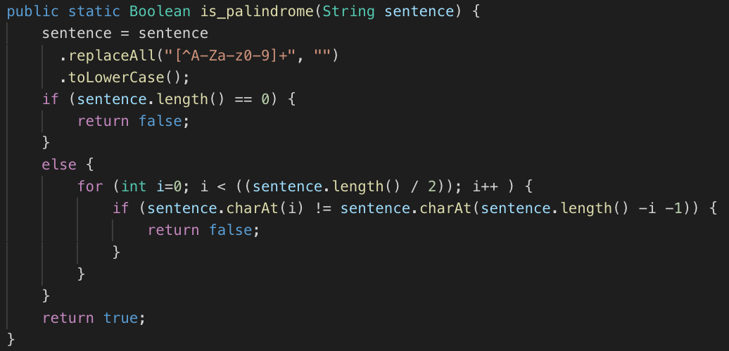
Two Problems, Java-Style

Slide 10
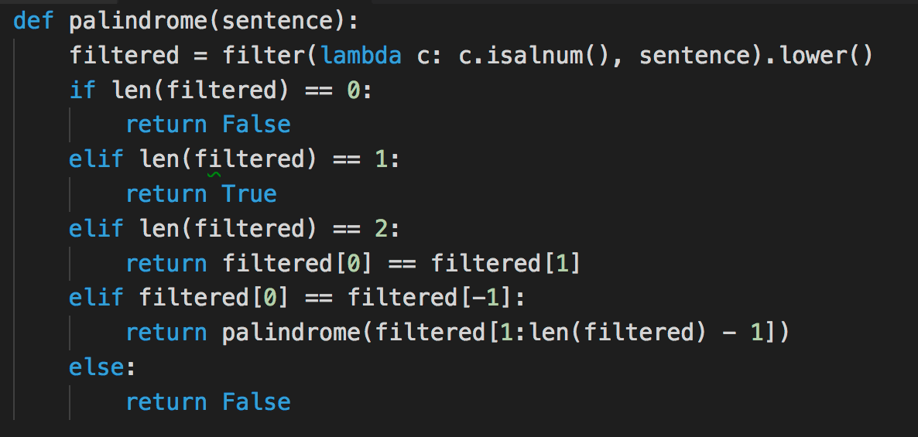
Recursive

Slide 11
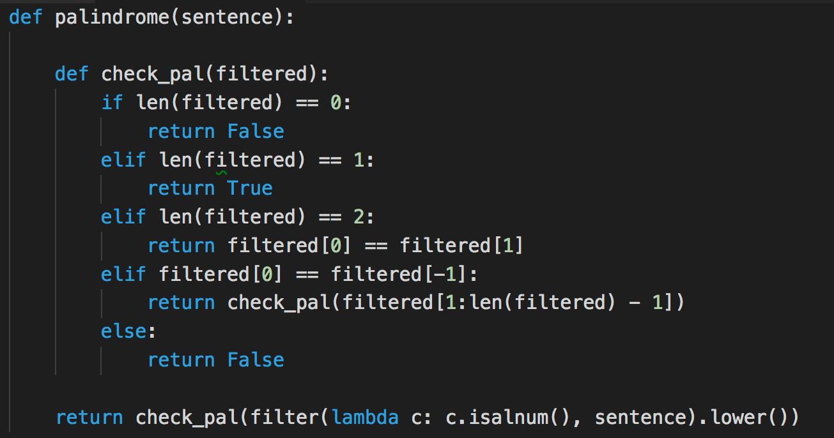
Optimizing the recursion

